Slide 1
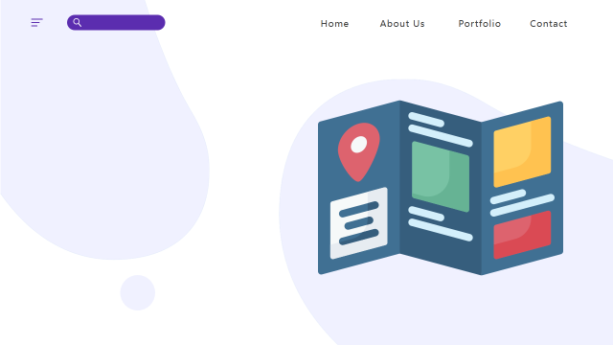
TOURISM
MANAGEMENT
SYSTEM

Slide 2

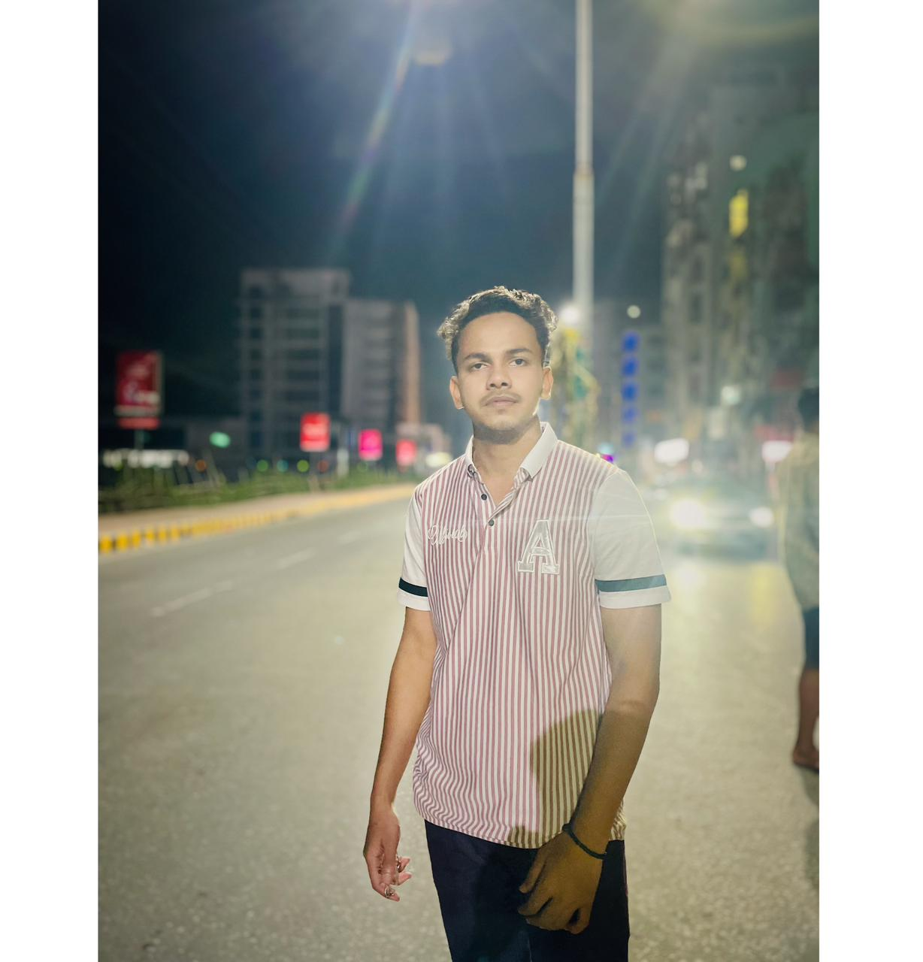
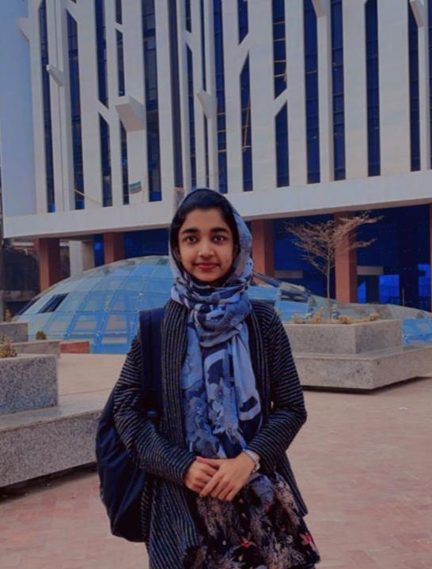
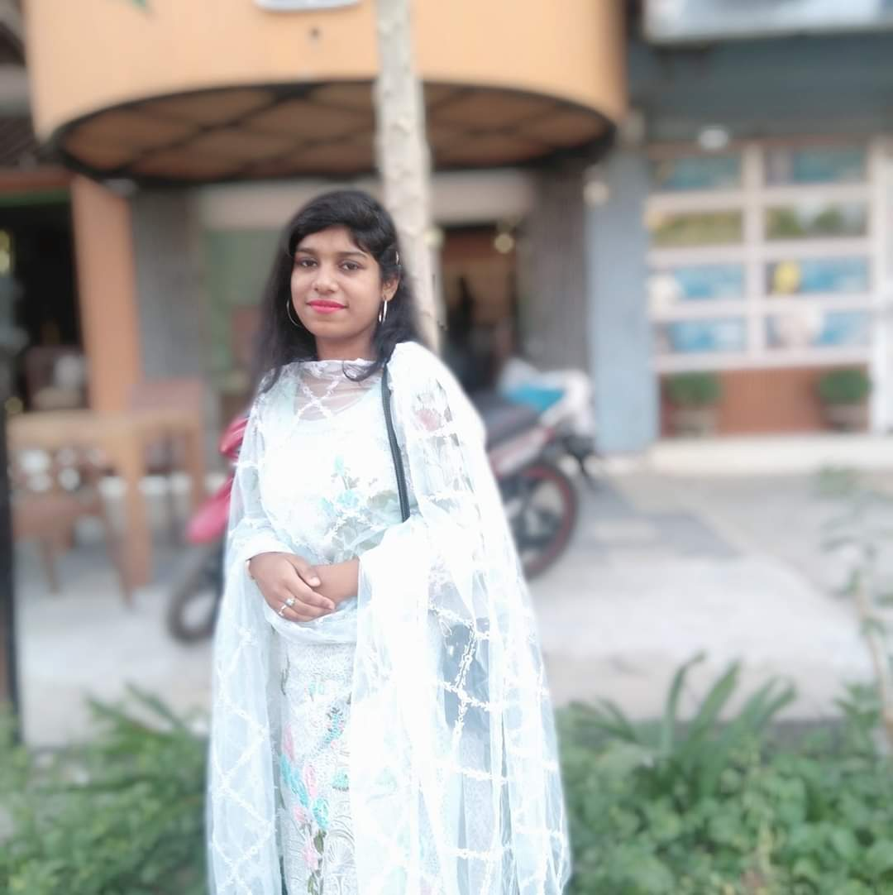


PRESENTED BY
Abdullah Al Rohan
Shabah Tasfiya
Farzana Nasir Barsha
Al Mahmud Jawad
Frontend Engineer
Backend Engineer
Backend Engineer
Frontend Engineer

Slide 3

CONTENTS
PPT模板 http://www.1ppt.com/moban/
Introduction
Objectives
Hardware & Software
System Architecture
Flowchart
Project Demonstration
Limitation
Future Enhancement
Contribution

Slide 4

INTRODUCTION
Significant growth in the travel industry due to technology and global tourism.
Increased demand for efficient and convenient trip planning solutions.
Rising expectation for user-friendly travel management platforms.
Introduction of a Travel Management System using the Laravel framework.
Aims to enhance travel experience by streamlining package management.

Slide 5

OBJECTIVES
Implement User Registration and Authentication
Develop Package Management System for Admins
Enable Package Booking for Customers
Create a Customer Dashboard
Implement Admin Dashboard for Booking and User Management

Slide 6


HARDWARE AND SOFTWARE REQUIREMENTS
Hardware Requirements
Minimum 4 GB RAM (8 GB recommended).
2 GHz dual-core processor or better.
At least 10 GB of free disk space.
Software Requirements
Operating System: Windows, macOS, or Linux.
PHP (version 8.0 or higher).
Laravel (version 9.x).
Database: MySQL (version 5.7 or higher) or SQLite.
Composer for dependency management.
Web server: Apache

Slide 7
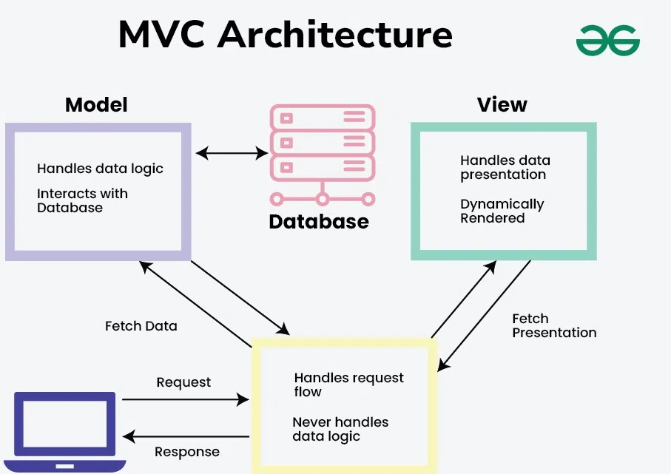


SYSTEM ARCHITECTURE

Slide 8
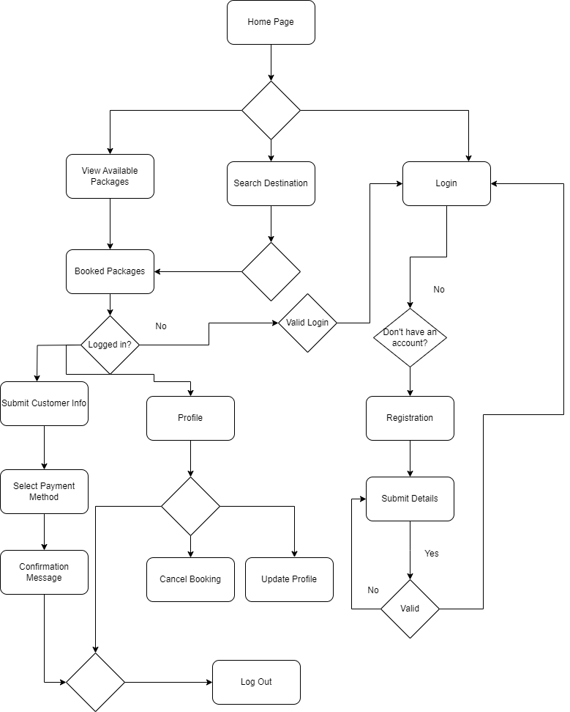

CUSTOMER FLOW CHART

Slide 9
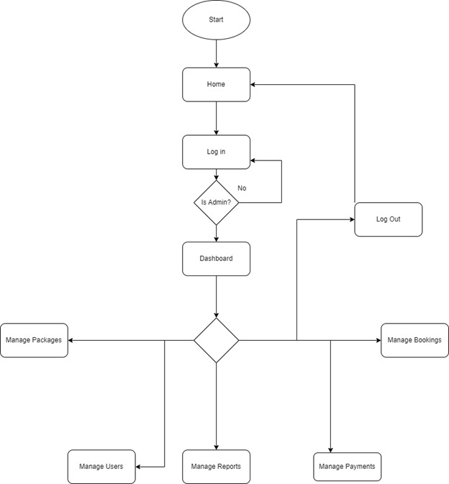

ADMIN FLOW CHART

Slide 10
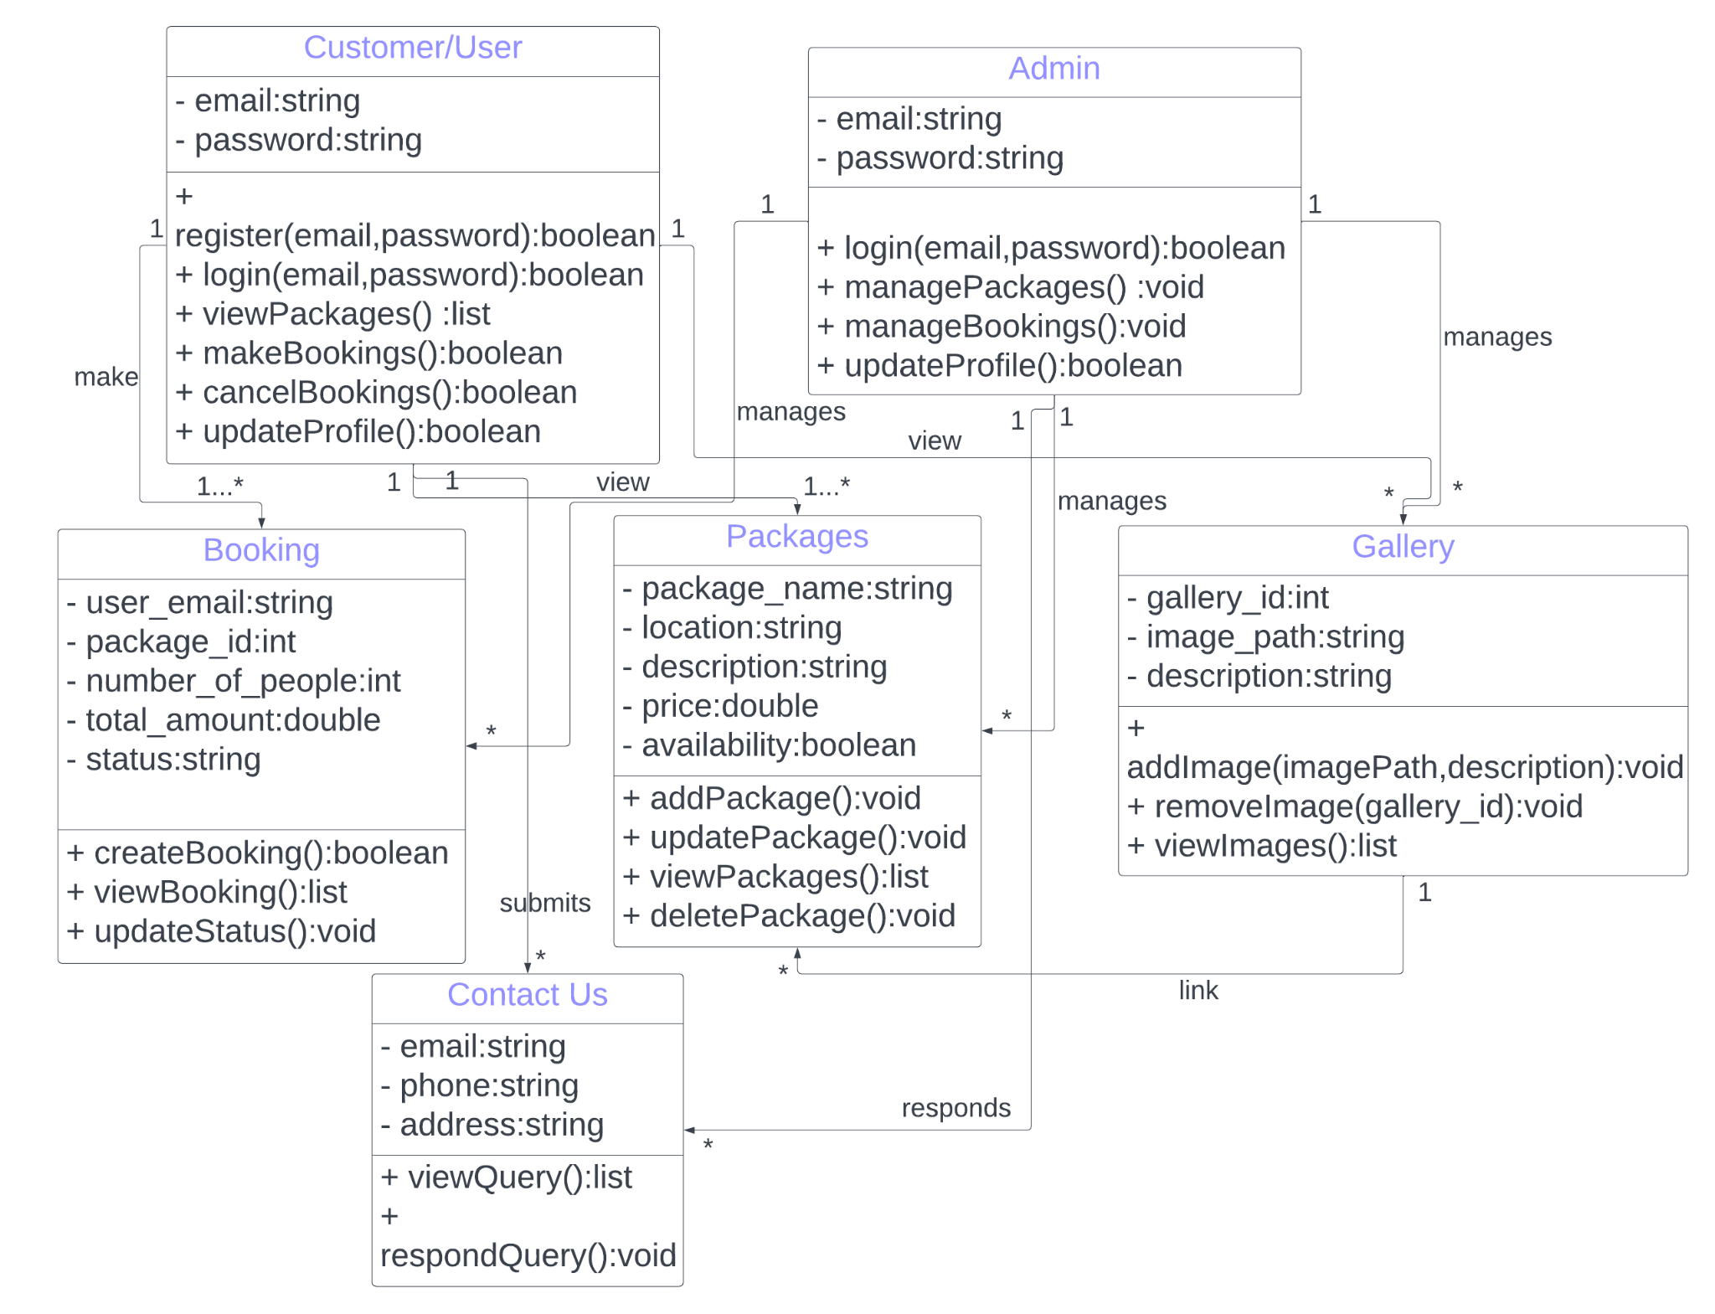
CLASS DIAGRAM

Slide 11
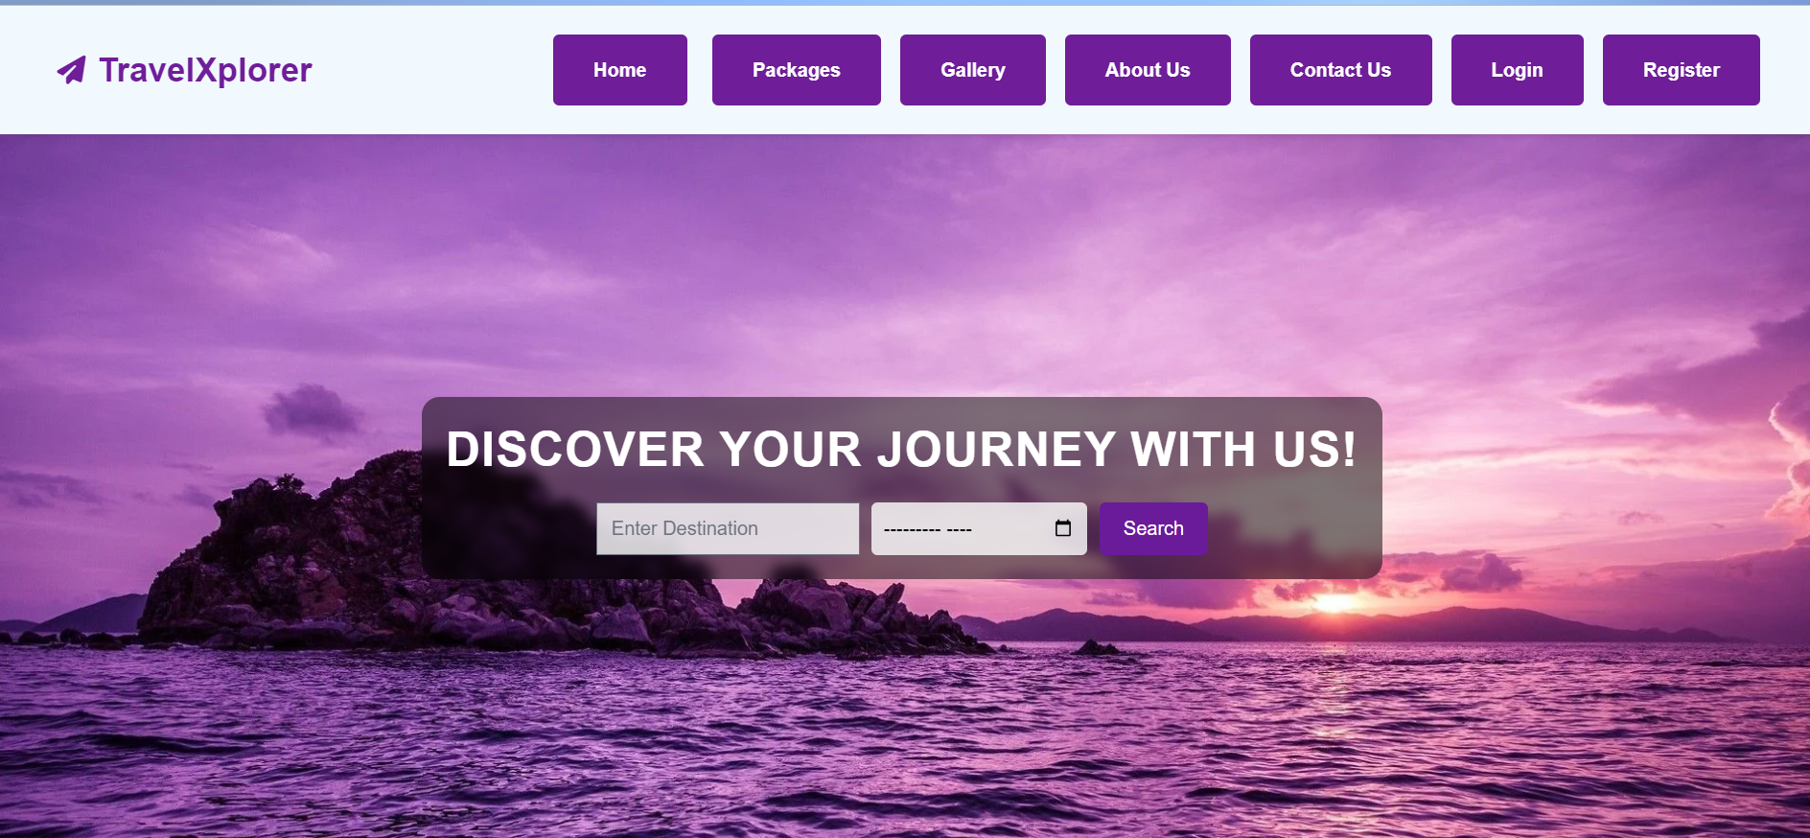
SEARCHING PACKAGES

Slide 12
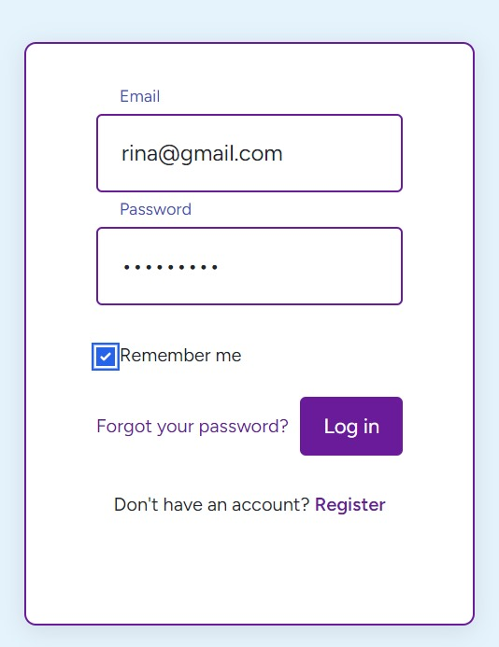
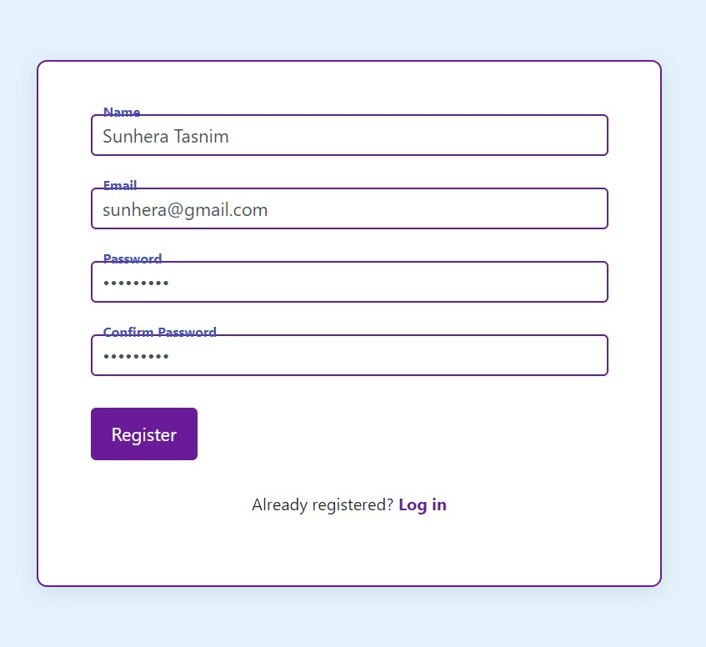
AUTHENTICATION

Slide 13
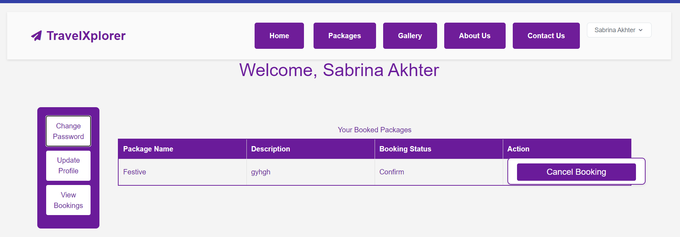
CUSTOMER DASHBOARD

Slide 14
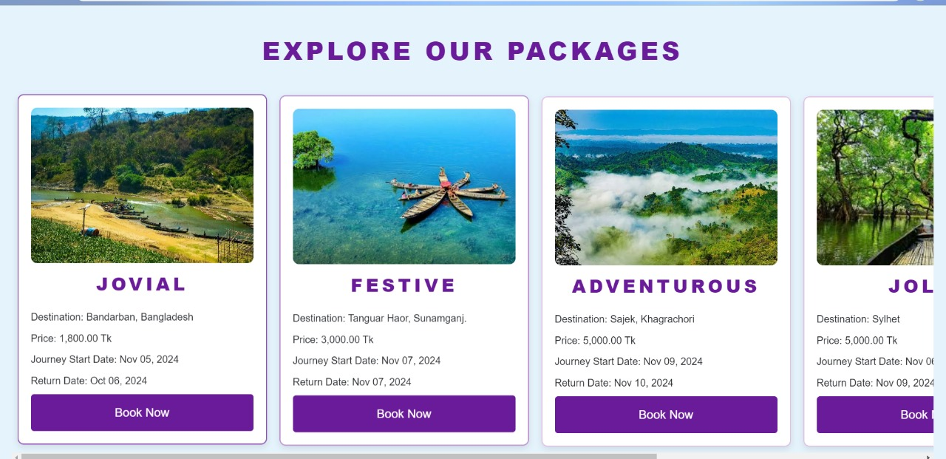
DISPLAY PACKAGES IN HOME PAGE

Slide 15
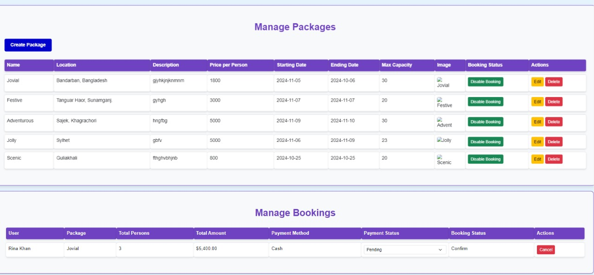
ADMIN PACKAGE AND BOOKING MANAGEMENT

Slide 16
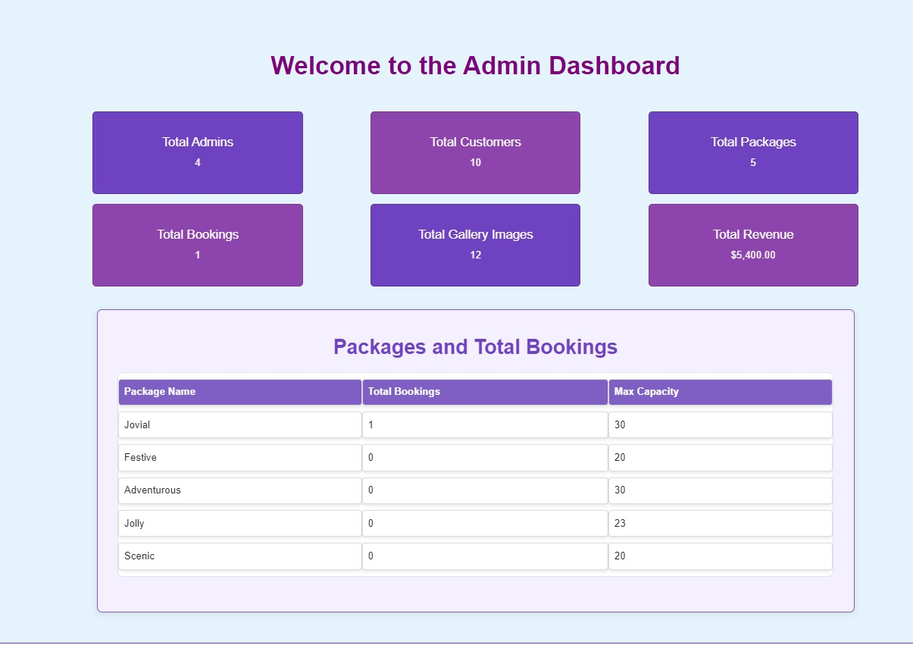
ADMIN DASHBOARD

Slide 17
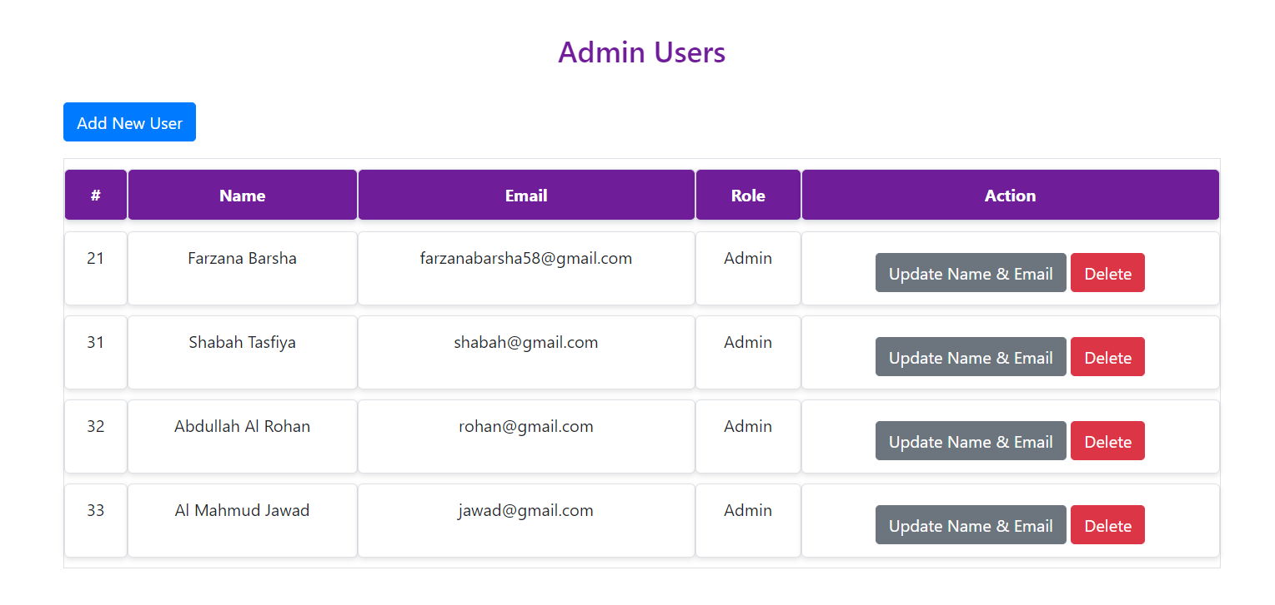
ADMIN USER MANAGEMENT

Slide 18

LIMITATION
Limited payment options
No real-time booking updates
Basic search filters
Basic user roles
No live chat support
Manual admin operations

Slide 19

FUTURE ENHANCEMENT
Expand payment options
Real-time booking updates
Advanced search filters
Enhanced role-based access
Live chat support
Automated admin tasks
Integration with third-party service

Slide 20

CONTRIBUTION
Name : Abdullah Al Rohan
Work: Authentication, Update Profile, Booking Cancellation
Name : Farzana Nasir Barsha
Work: Package and Booking Management
Name : Shabah Tasfiya
Work: Gallery Management, Admin Dashboard
Name : Al Mahmud Jawad
Work: User Management, Contact Us Management.

Slide 21

THANK YOU !

